Slide 1
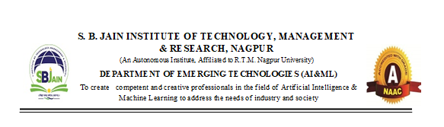

“Intelligent Home Automation System Using Gen AI and IoT”
Presented By
Ms. Vaishnavi Rahamatkar
Mr. Atharva Wakdikar
Mr. Ayush Roy
Ms. Vaishnavi Dhekwar
Under the Guidance
of
Prof. Yogesh Narekar
Session:2024-25 (ODD )
Department of Emerging Technologies (AI&ML and AI&DS)
S. B. JAIN INSTITUTE OF TECHNOLOGY MANAGEMENT AND RESEARCH,NAGPUR
An Autonomous Institute, Affiliated to RTMNU, Nagpur

Slide 2
CONTENTS
Introduction
Project Overview
Literature Review
Methodology
Progress So Far
Current Status
Future work
Conclusion
References
S. B. Jain Institute of Technology Management and research
2

Slide 3
INTRODUCTION “Intelligent Home Automation System Using Gen AI and IoT for Personalized Energy Management to Reduce Carbon Footprint”
The Intelligent Home Automation System that integrates Generative AI and the Internet of Things (IoT) represents a cutting-edge approach to personalized energy management. This system enables homeowners to optimize energy consumption through real-time monitoring and intelligent automation. By connecting smart devices—such as thermostats, lighting, and appliances—these systems can analyze usage patterns and environmental data to provide tailored recommendations. The use of Generative AI enhances this functionality by predicting energy needs and adapting settings to maximize efficiency. This not only helps reduce energy bills but also significantly lowers the carbon footprint of households, contributing to a more sustainable environment. As energy conservation becomes increasingly important, such smart home technologies offer a practical solution for individuals to actively engage in eco-friendly practices while enjoying the conveniences of modern living.

Slide 4
PROJECT OVERVIEW
This project aims to develop an advanced home automation system that leverages the power of Generative AI (Gen AI) and Internet of Things (IoT) technologies to create a personalized energy management solution. The system utilizes the ESP8266 microcontroller, along with various environmental sensors such as light, temperature, and motion detectors, to gather real-time data from the home environment. By analyzing this data, the Gen AI model will learn the habits and preferences of the household occupants, enabling it to predict and automate the control of household appliances. This intelligent system is designed to optimize energy consumption, enhance user comfort, and reduce the household's carbon footprint. The project highlights the potential of combining AI and IoT for sustainable and efficient living.

Slide 5
Project Objectives
Implement IoT-enabled sensors and devices to continuously monitor energy consumption patterns and environmental conditions within the home.
Design and integrate automated controls that adjust energy settings in real time, ensuring maximum efficiency without compromising comfort.
Design the system to be scalable and adaptable to different household sizes and types, ensuring broad applicability and ease of implementation.
Develop a user-friendly interface that provides tailored suggestions for optimizing energy use, such as adjusting heating, cooling, and lighting settings based on occupancy and individual habits.
Ensure seamless connectivity and interoperability among various smart home devices to create a cohesive energy management ecosystem.
S. B. Jain Institute of Technology Management and research
5

Slide 6
LITERATURE REVIEW
S. B. Jain Institute of Technology Management and research
6

Slide 7
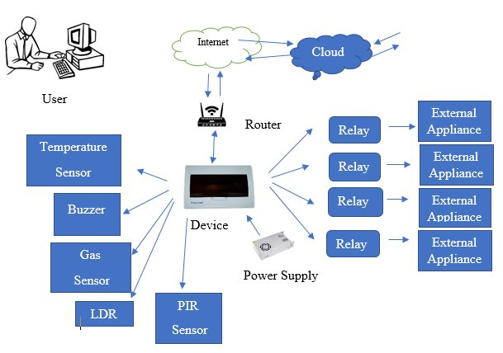
METHODOLOGY

Slide 8
IoT Architecture: The hardware setup of the system, including sensors, microcontroller, and communication protocols.
Data Collection: The ESP8266 gathers temperature, light, and motion data in real time from the connected sensors.
Gen AI Processing: The AI model analyzes historical data, learning the user’s behavior and environmental patterns to predict when appliances should be turned on or off.
Automation: Based on AI predictions and sensor data, the system controls appliances, such as turning lights off when the room is vacant and adjusting light intensity based on ambient light levels.
User Interface: Data and system status are sent to ThingSpeak, where the user can view live updates and control settings through a user-friendly dashboard.
Testing and Validation :An important part of the scope involves the thorough testing and validation of the system in real-world environments.

Slide 9
TOOLS AND TECHNOLOGIES USED
Hardware:-
Microcontroller: ESP8266 (Nodemcu)
Sensors: Light (LDR sensor)
Temperature (DHT11 sensor)
Motion (PIR sensor)
Programming Languages: C++ (for ESP8266)
Software:-
Frontend: HTML, CSS
Backend:PHP/MySQL (CURD Operation)
Cloud Platform:- Thingspeak (MATLAB)

Slide 10
PROGRESS SO FAR
Completed Tasks:
Hardware Setup Complete: ESP8266 and sensors are assembled.
Sensor Connections Established: DHT11, PIR, and LDR are connected.
Programming has been completed with thingspeak connection.
ThingSpeak Integration: Data is being sent to ThingSpeak for monitoring.
Challenges Faced:
Ensuring stable communication between sensors and ESP8266.
Debugging hardware setup issues and refining data collection protocols.
Reliability: For home automation to succeed, developers should address considerations regarding the dependability of sensible devices compared with ancient home appliances and equipments.
Date Collection and Use: Many connected home and smart products rely on value propositions that are in part about new functionality, and in part about the 'smarter' use of resources. In order to achieve this, data flows between the devices and servers operated by the device providers, between devices, and to and from the consumer's smart phone or computer.
S. B. Jain Institute of Technology Management and research

Slide 11
FUTURE WORK
Integration of Additional Sensors: o Incorporate more sensors (e.g., humidity, CO2) to enhance environmental monitoring and improve automation capabilities.
Advanced Machine Learning Models: o Develop more sophisticated AI algorithms to better predict user behavior and optimize energy consumption, potentially integrating reinforcement learning techniques.
User Personalization Features: o Enhance user interfaces with customizable settings and preferences, allowing for more tailored automation and control options.
Mobile Application Development: o Create a dedicated mobile application for improved user interaction, enabling real-time monitoring, control, and notifications directly from smartphones.
Scalability and Interoperability: o Expand the system to support more devices and appliances, ensuring compatibility with various IoT standards and protocols for broader adoption in smart homes.
S. B. Jain Institute of Technology Management and research
11

Slide 12
CONCLUSION
The "Intelligent Home Automation System Using Gen AI and IoT for Personalized Energy Management" project aims to create a smart home solution that combines Generative AI with IoT technology to optimize energy usage and reduce carbon footprints. By integrating ESP8266 microcontrollers with various environmental sensors and developing a robust web application, the system will collect real-time data, learn user preferences, and automate appliance control. This approach promises enhanced energy efficiency, user comfort, and environmental sustainability. The project's successful implementation will demonstrate the significant potential of combining AI and IoT for creating smarter, greener homes.
S. B. Jain Institute of Technology Management and research
12

Slide 13
REFERENCES
Papers:
"Artificial Intelligence in Smart Home Systems: A Survey" by K. A. A. Omar et al. (2022).
"Energy Efficiency in Smart Homes: A Comprehensive Review" by M. H. N. Nguyen et al. (2023).
"Generative Adversarial Networks for Energy Management in Smart Grids: A Survey" by J. J. Li et al. (2023).
Books:
Internet of Things (IoT): A Hands-On-Approach: Bhaskar Krishnamachari (2017)
Generative Deep Learning: Teaching Machines to Paint, Write, Compose, and Play: David Foster (2021)
Smart Home Automation with Linux and Raspberry Pi: Steven Goodwin (2017)
Websites:
https://youtu.be/UixNfOySIsA?si=di945udoLwZjVGCl
https://youtu.be/kyuo0JpZtBE?si=RK8MOlR_n6TiXKQs
https://youtu.be/aTFpYflYOG4?si=KMt4hs-NPW36Etr1
S. B. Jain Institute of Technology Management and research
13

Slide 14
Thank You
S. B. Jain Institute of Technology Management and research

